Slide 1
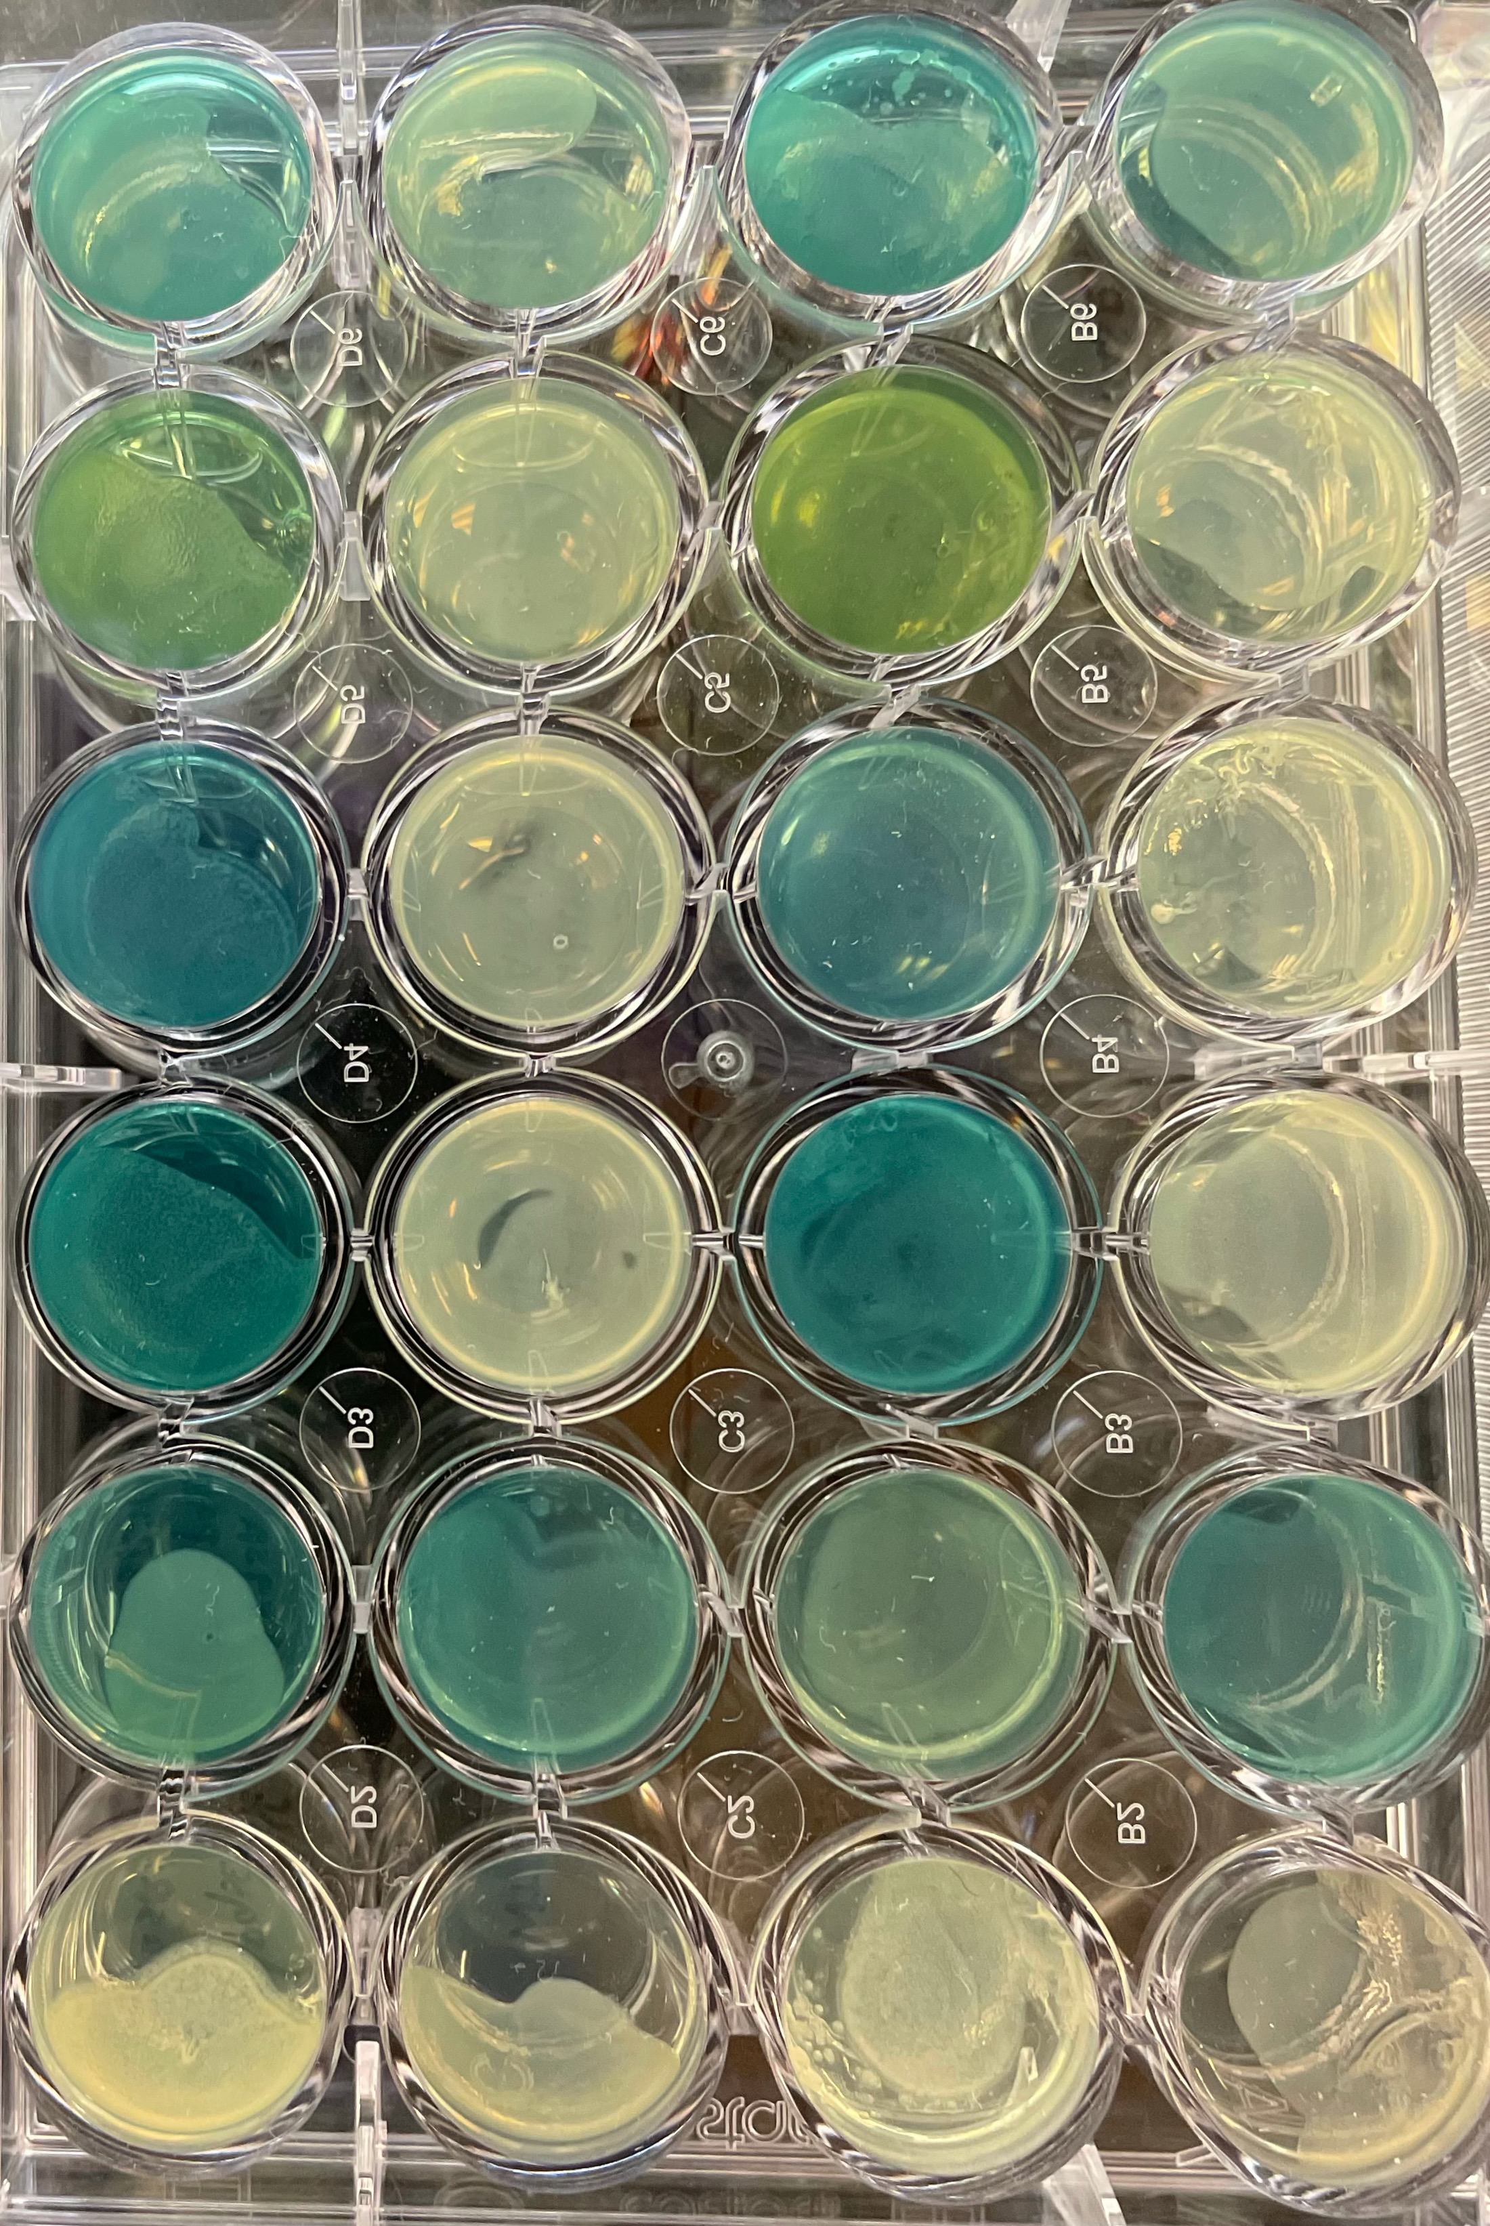
Modeling quorum sensing cycles in P. aeruginosa using longitudinal approaches by measuring gene expression
Maryam Abdel-Azim
Project ID: MCRO058
Central Bucks High School East, Doylestown, PA, USA
All images were taken by the finalist

Slide 2
Background:
Quorum sensing is the process of cell-cell communication for the purpose of acquiring information about the cellular density in the environment.
This process enables bacteria to behave in a synchronous manner to regulate gene expression, allowing for a magnified effect.
Pseudomonas aeruginosa is a gram-negative, opportunistic pathogen involved in many diseases .
These diseases include Cystic fibrosis, enophthalmos, and pneumonia
The biofilm production and the bacteria’s use of pyocyanin play large roles in P. aeruginosa virulence. Biofilms protect the bacteria from their surroundings, allowing their survival under environmental stress such as antibiotics exposure. Pyocyanin is a toxic phenazine released by P. aeruginosa to eliminate all other competing microbes in the environment, in addition to the lung cells of a cystic fibrosis-affected patient.
Purpose:
In this study, I accurately identified the role and rank of critical genes to QS. This allows for those genes to be used as drug targets, preventing P. aeruginosa from gaining antibiotic resistance.
I developed a robust a statistical technique to accurately measure QS activities by observing the entire cycle while adjusting for interfering confounders. The method is useful for integration with medical devices software.
Hypothesis:
The quantification of QS can be made significantly more precise and accurate using longitudinal statistical modeling, as opposed to raw, unprocessed fluorescence data recorded at one time point.
Notes:
QS is associated with biofilm and pyocyanin production
Find dif curves and device a method that can dif btwn curves of dif strains to sensitively measure qs acivites throuhgout the cycle -- when u cover whole cycle, u are more accurate
Define genes and rank them -- subset of genes affect qs differently
Developed approach to be implemented to understand genetic basis of qs
Implemented approach in seconf trial
Developed approach to accurately measure qs activity and identify small. Deffernces and in second the approach is implemented to understand role of genes in qs and identify subset of genes to identify role in qs

Slide 3
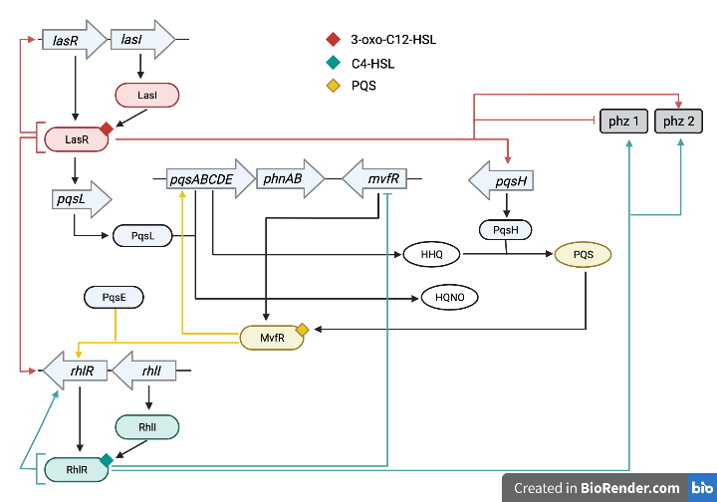
Background: Schematic of quorum sensing pathway in P. aeruginosa
Different shapes represent different components of the cycle:
genes, proteins, autoinducers, molecules, and phenazines.
Different colors represent the 3 main quorum sensing (QS) systems in the pathway
Las, Rhl, Mvf/Pqs
Colored arrows and lines represent the activation or inhibition of certain genes or phenazines.
Autoinducers:
All images were generated by the finalist
Quorum sensing pathway proposed for P. aeruginosa
Notes:
Arrows represent genes, curved rectangles represent proteins, diamond shapes represent autoinducers or signals
The red color represents the Las QuSensing system, the yellow represents the pqs/Mvf qs system, and the green represents the Rhl system
Proteins like LasI and RhlI code for qs signaling molecules called autoinducers that bind to their associated protein

Slide 4
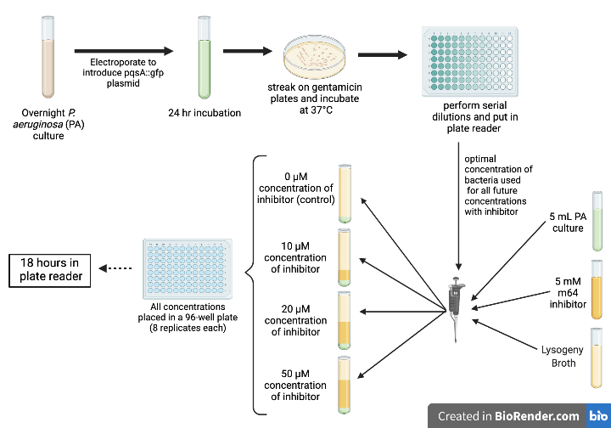
Methods: Experimental design for inhibition strains
Introduce plasmid with GFP (green fluorescent protein) tagged to pqsA to monitor bacterial activity through the cycle
pqsA plays a large role in QS
8 replicates were used for each concentration of M64 inhibitor
4 different concentrations of M64, were used to interrupt QS
M64 inhibits MvfR, and thus interrupts the QS cycle (clarified in pathway)
All replicates (in a 96-well plate) were placed in a plate reader for 18 hours, collecting fluorescence and absorbance data for each well every 20 minutes
All images were generated by the finalist
Notes:
explain that inhibition strains are the strains that have teh inhibitor
Progression through the cycle is measured through the gene expression of pqsA, since the gfp tag illuminates more intensely as gene
Expression increases

Slide 5
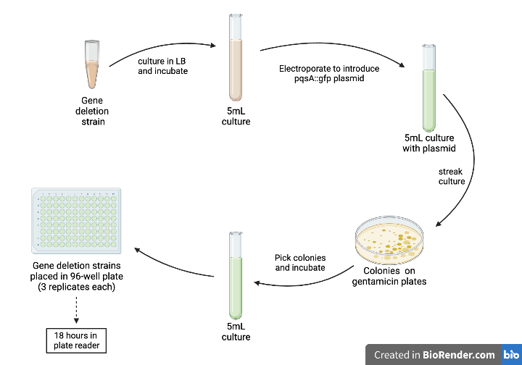
Methods: Experimental design for gene deletion strains
The procedure below was carried out for 8 different strains, with 3 replicates each
Each strain has a different gene deleted
After the bacteria were electroporated to introduce the pqsA-tagged GFP plasmid, the culture was grown and streaked on gentamicin plates
This ensured that all live colonies had the plasmid when they were picked
Bacteria were grown in a liquid culture until it reached an absorbance value of 1.
20µL of bacteria were then pipetted into each well with 230µL of LB. The well plate was placed in a plate reader
Data was collected for 18 hours every 20 minutes
Gene Deletions of each strain:
lasR
rhlR
pqsA::CTX PqsE
pqsE
pqsL
pqsBC
pqsH
mvfR
All images were generated by the finalist
Notes:
plate reader took flousrescence and absorbance readings every 20 min for 18 hours

Slide 6
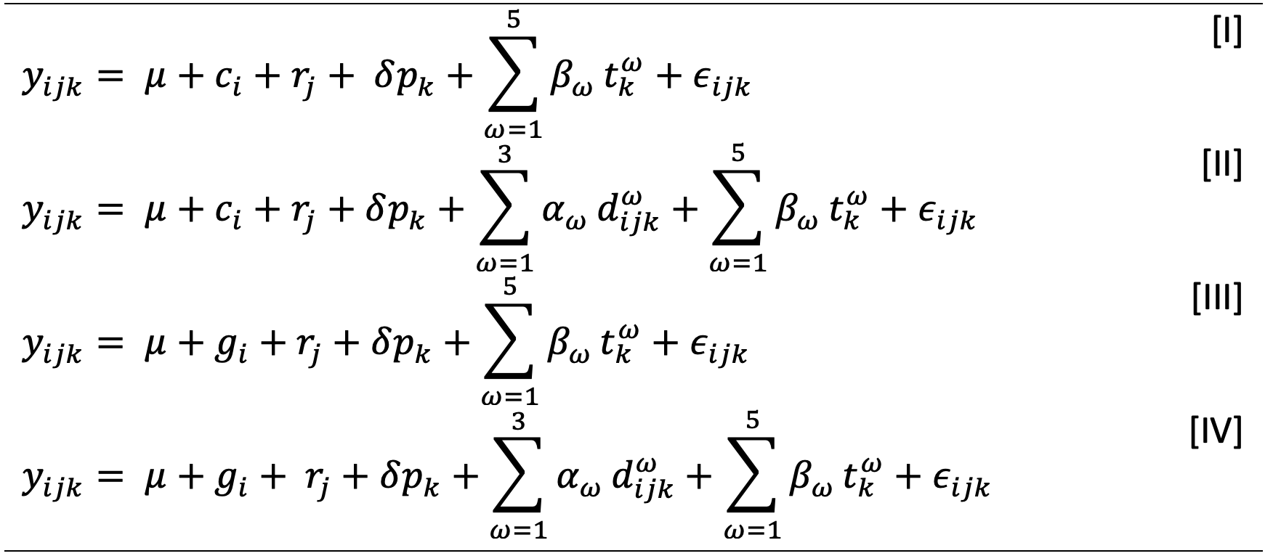
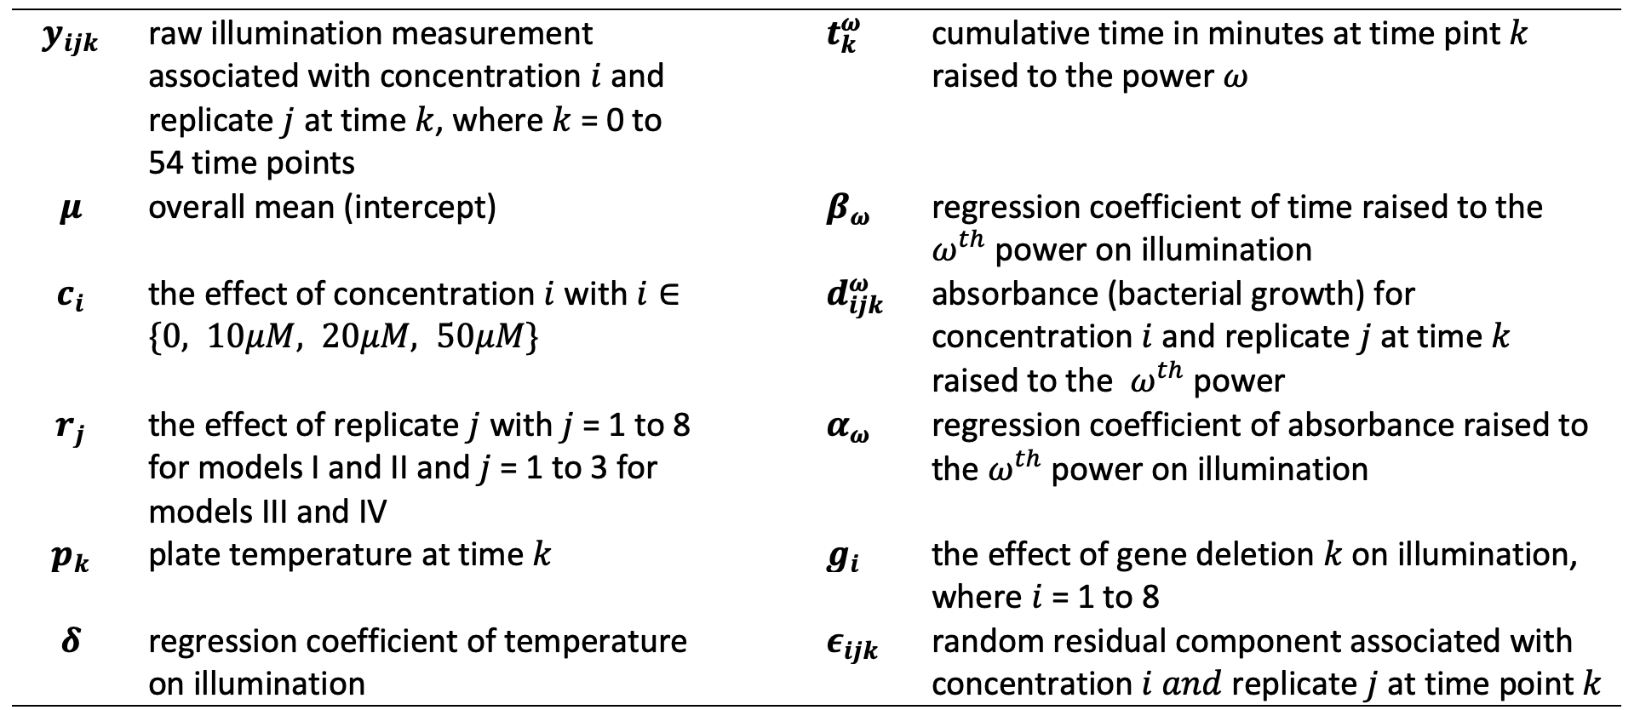
Methods: Models developed for the experiment using LQSM (Longitudinal Quorum Sensing Modeling)
Covariates included: concentration, gene deletion, replicate, bacterial growth (OD), temperature, and time.

Slide 7
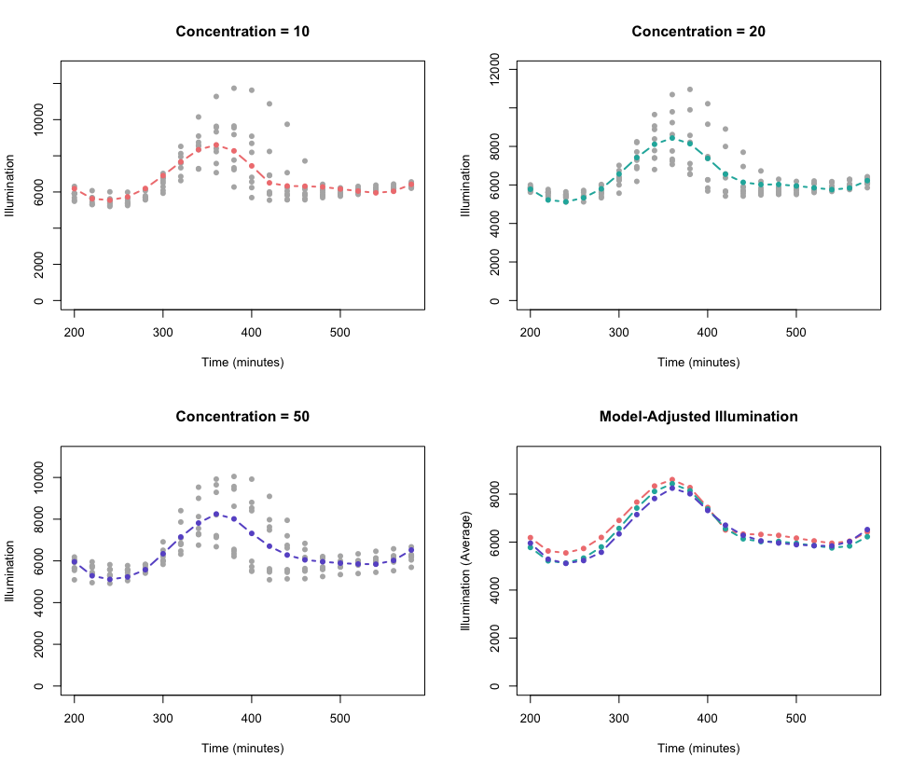
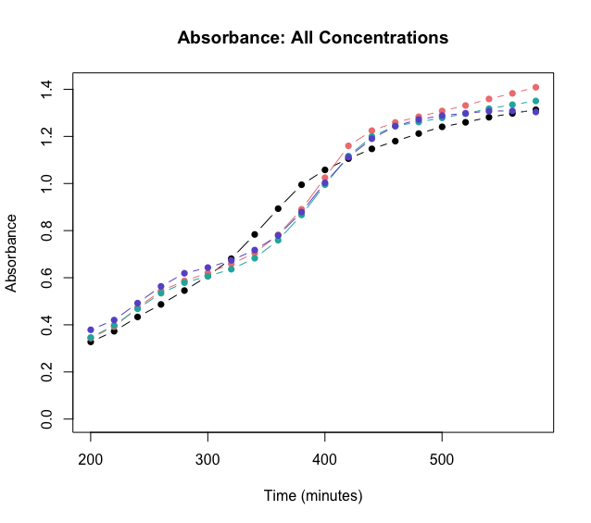
Results: Quorum sensing cycle of each concentration was correctly measured by LQSM
A plot comparing concentration estimates of models I and II, where model I (red) ignores OD (bacterial growth) and model II (black) adjusts for all confounders, including OD.
A plot of raw fluorescence against time for concentrations 10, 20, and 50µM for the time interval between 200 and 600 minutes. OD-adjusted fluorescence is shown in colored lines. Curves were developed based on estimates of Model II.
OD: All Concentrations
Optical Density (OD)
All images were generated by the finalist
Notes:
Say that plate reader measure absorbacne of bacteria which is growth

Slide 8
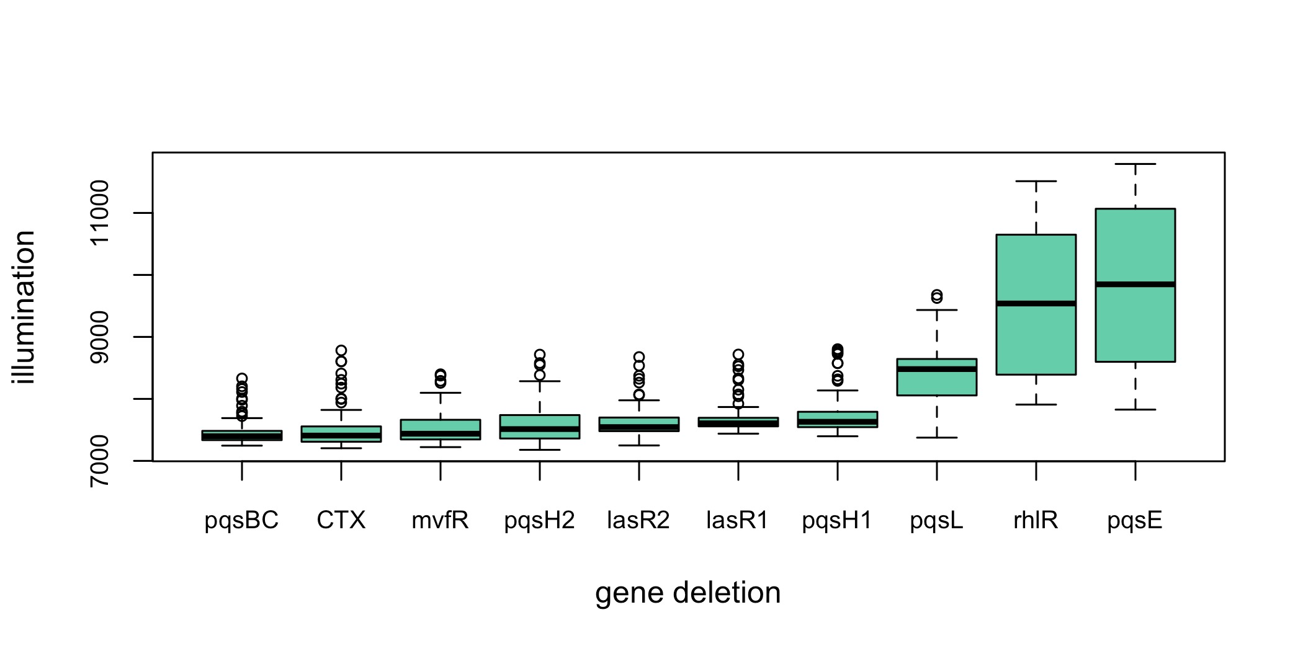
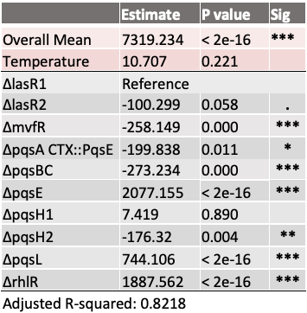
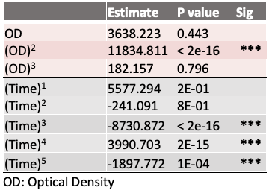
Results: Applying LQSM to different gene deletion strains
Boxplots of raw fluorescence data ordered lowest to highest.
Model IV estimates of fitting fluorescence against gene deletion type, orthogonal polynomials of time to the 5th power and OD to the 3rd power, and temperature.
All images were generated by the finalist
Notes:
Dealing with every del in the same way as we did in the concentrations from before
Can build a curve for each strains as we did for concentration
Remember that approach was validated using M64 concentrations and now it is applied to gene dels
Each gene name means that is the deletion of the strain
Reference deletion is lasR1
Las R1 and LasR2
Significantly different strains
Not only ranks, but quantifies whole cycle
Change all decimals to 3

Slide 9
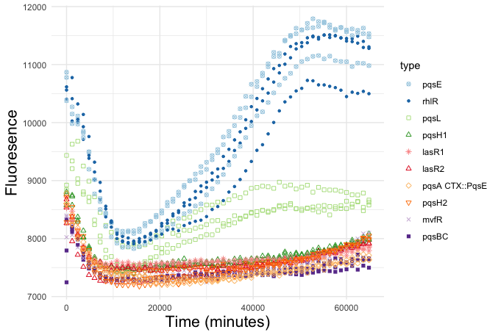
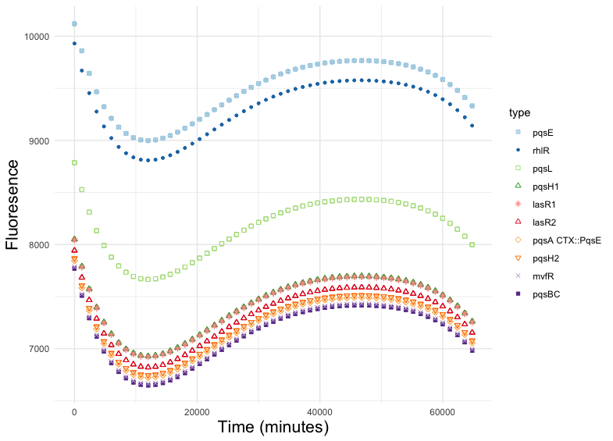
Results: Quorum sensing cycle of each gene deletion strain is distinctively ranked based on LQSM
Plot of raw fluorescence for all the gene deletion strains against time
Plot of OD-adjusted fluorescence for all the gene deletion strains. Factors such as OD, temperature, and type of gene deletion strain are accounted for in each curve.
All images were generated by the finalist
Notes:
When use model distinctive curve

Slide 10
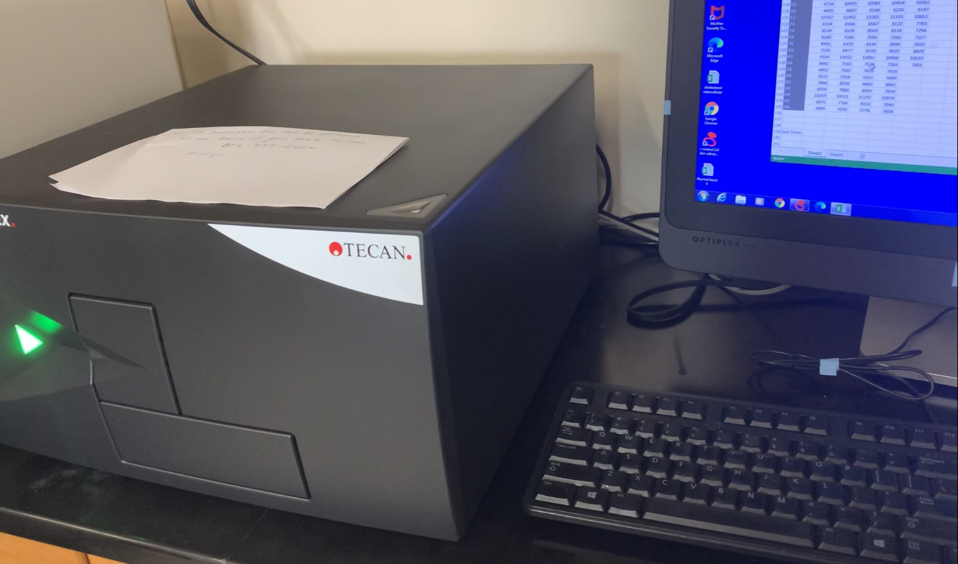
Analysis
Inhibition strains:
The QS curves of the different concentrations (figure 1) become more depressed with higher M64 (MvfR inhibitor) concentrations.
Validates Longitudinal Quorum Sensing Modeling approach (LQSM)
Gene deletion strains:
LQSM was successfully implemented in ranking gene deletion strains based on their QS activity through time.
pqsE deletion strain was shown to have the highest fluorescence, which is biologically sound since that gene inhibits pqsA
GFP is tagged to pqsA, so as the expression of pqsA increases, fluorescence increases
The deletion of pqsBC resulted in the strain with the lowest fluorescence, showing that it is the most relevant gene in the QS cycle.
pqsH gene deletion strain was ranked low, meaning weaker QS activity. According to the QS pathway in P. aeruginosa (Slide 3), pqsH controls the production of PQS, which serves as an autoinducer to activate MvfR. This gene deletion strain had a great impact on QS because it disrupts an upstream process that affects the activation of multiple other genes.
Accounting for OD in LQSM was essential. A Model without OD resulted in assessing higher QS activity with concentration 50µM than 20µM, which is biologically incorrect.
Photo taken by me at Rahme Laboratory
Notes:
The peak of each concentration are around the same time since they all have the same amount of bacteria (M64 only inhibits mvfR, it does not kill bacteria)
All concentrations rise at the same rate since they are also growing at the same rate (OD plot)
Say in video that gene del analysis are key points

Slide 11
Future:
Conclusions
A Longitudinal modeling approach for QS was developed and validated using multiple concentrations of M64 inhibitor
The approach was successfully applied to bacterial strains with a variety of gene deletions that impact QS. Gene deletions were ranked according to their QS activity which showed the importance of each gene for the QS pathway of P. aeruginosa
It is shown that raw fluorescence data, even if collected almost continuously overtime, still gave wrong conclusions if it is not statistically adjusted for important covariates such as bacterial growth.
It is recommended that LQSM is to be integrated in the software of medical and laboratory devices that collect data through time. For devices that do not accommodate this, careful statistical treatment of the data is highly recommended.
Suppress the expression of QS in P. aeruginosa (and other bacteria like S. aureus) by targeting autoinducers in the environment instead of genes. If bacteria cannot sense autoinducers in the environment, they will not activate their virulent properties. The LQSM approach will be used to compare the effectiveness of the two approaches.
Signal molecule-sequestering polymers (SSPs) will be used to target autoinducers
P. aeruginosa is an extremely virulent organism with strong capabilities to mutate and acquire resistance against anti-bacterial drugs. Attenuating the evolutionary power of P. aeruginosa against drugs using anti-QS compounds will be studied as a combination treatment to sustain the effectiveness of drugs and prevent bacteria from gaining resistance. LQSM will be a precise tool to evaluate and compare compounds.
This gives hope to Cystic fibrosis patients who suffer from P. aeruginosa infection
Notes:
In this case, those factors and OD
If one gene deletion strain had a lower flourscence curve, it can mean that the reworking of the qs cycle could be more difficult for that
Studying the efficacy can lead to finding the optimal drugs for each mutation (can be done for other infections, not just PA)
I could compare the efficacy of suppressing genes and targeting autoinducers to determine the best method of treatment
Can apply so other infections, other than ones caused by Pseudomonas
Actual data without modeling is not useful – actual data taken from apparatus is not useful

Slide 12
Selected References
Maura, Damien, and Laurence G Rahme. “Pharmacological Inhibition of the Pseudomonas aeruginosa MvfR Quorum-Sensing System Interferes with Biofilm Formation and Potentiates Antibiotic-Mediated Biofilm Disruption.” Antimicrobial agents and chemotherapy vol. 61,12 e01362-17. 22 Nov. 2017, doi:10.1128/AAC.01362-17
Abisado, Rhea G., et al. “Bacterial Quorum Sensing and Microbial Community Interactions.” MBio, vol. 9, no. 3, 2018, doi:10.1128/mbio.02331-17.
Hoffman, Lucas R., et al. “Pseudomonas Aeruginosa Lasr Mutants Are Associated with Cystic Fibrosis Lung Disease Progression.” Journal of Cystic Fibrosis, vol. 8, no. 1, 2009, pp. 66–70., https://doi.org/10.1016/j.jcf.2008.09.006.
Yang, Liang et al. “Effects of iron on DNA release and biofilm development by Pseudomonas aeruginosa.” Microbiology (Reading, England) vol. 153,Pt 5 (2007): 1318-1328. doi:10.1099/mic.0.2006/004911-0
Reuter, Kerstin et al. “Interfering with Bacterial Quorum Sensing.” Perspectives in medicinal chemistry vol. 8 1-15. 18 Jan. 2016, doi:10.4137/PMC.S13209
Starkey, Melissa, et al. “Identification of Anti-Virulence Compounds That Disrupt Quorum-Sensing Regulated Acute and Persistent Pathogenicity.” PLoS Pathogens, vol. 10, no. 8, 2014, https://doi.org/10.1371/journal.ppat.1004321.
Mould, D. L., Botelho, N. J., & Hogan, D. A. (2020). Intraspecies signaling between common variants of pseudomonas aeruginosa increases production of quorum-sensing-controlled virulence factors. MBio, 11(4). https://doi.org/10.1128/mbio.01865-20
Deng, Xin et al. “Proteome-wide quantification and characterization of oxidation-sensitive cysteines in pathogenic bacteria.” Cell host & microbe vol. 13,3 (2013): 358-70. doi:10.1016/j.chom.2013.02.004
Guendouze, Assia et al. “Effect of Quorum Quenching Lactonase in Clinical Isolates of Pseudomonas aeruginosa and Comparison with Quorum Sensing Inhibitors.” Frontiers in microbiology vol. 8 227. 14 Feb. 2017, doi:10.3389/fmicb.2017.00227

